Slide 1
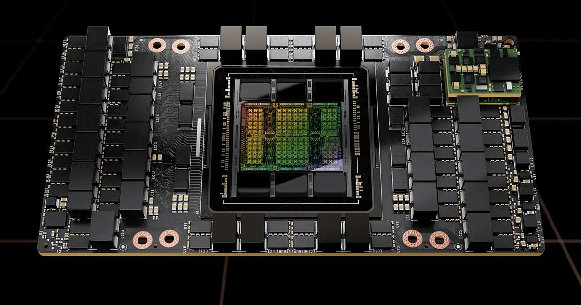
PČG Writing challenge 2024
Essay writing competition exclusively for students of První české gymnázium v Karlových Varech
Answer the following question in no more than 600 words:
“In your view, how will AI change education? Where would you allow students to use AI and where not and why?”
Deadline for submissions is March 22nd, 2024
Use of AI is allowed but subject to rules and implications for essay scoring – please consult full rules
1st prize: new iPhone SE + subscription to Wired and National Geographic for 1 year + Discover participation fee
2nd prize: subscription to Wired and National Geographic for 1 year + Discover participation fee
3rd prize: subscription to National Geographic for 1 year + Discover participation fee
The competition is open to students of years V-VIII of the 8-year PČG programme and all students of the 4-year PČG programme
Full competition rules are available at the office of Mgr. Simona Prošková during her office hours

